Slide 1
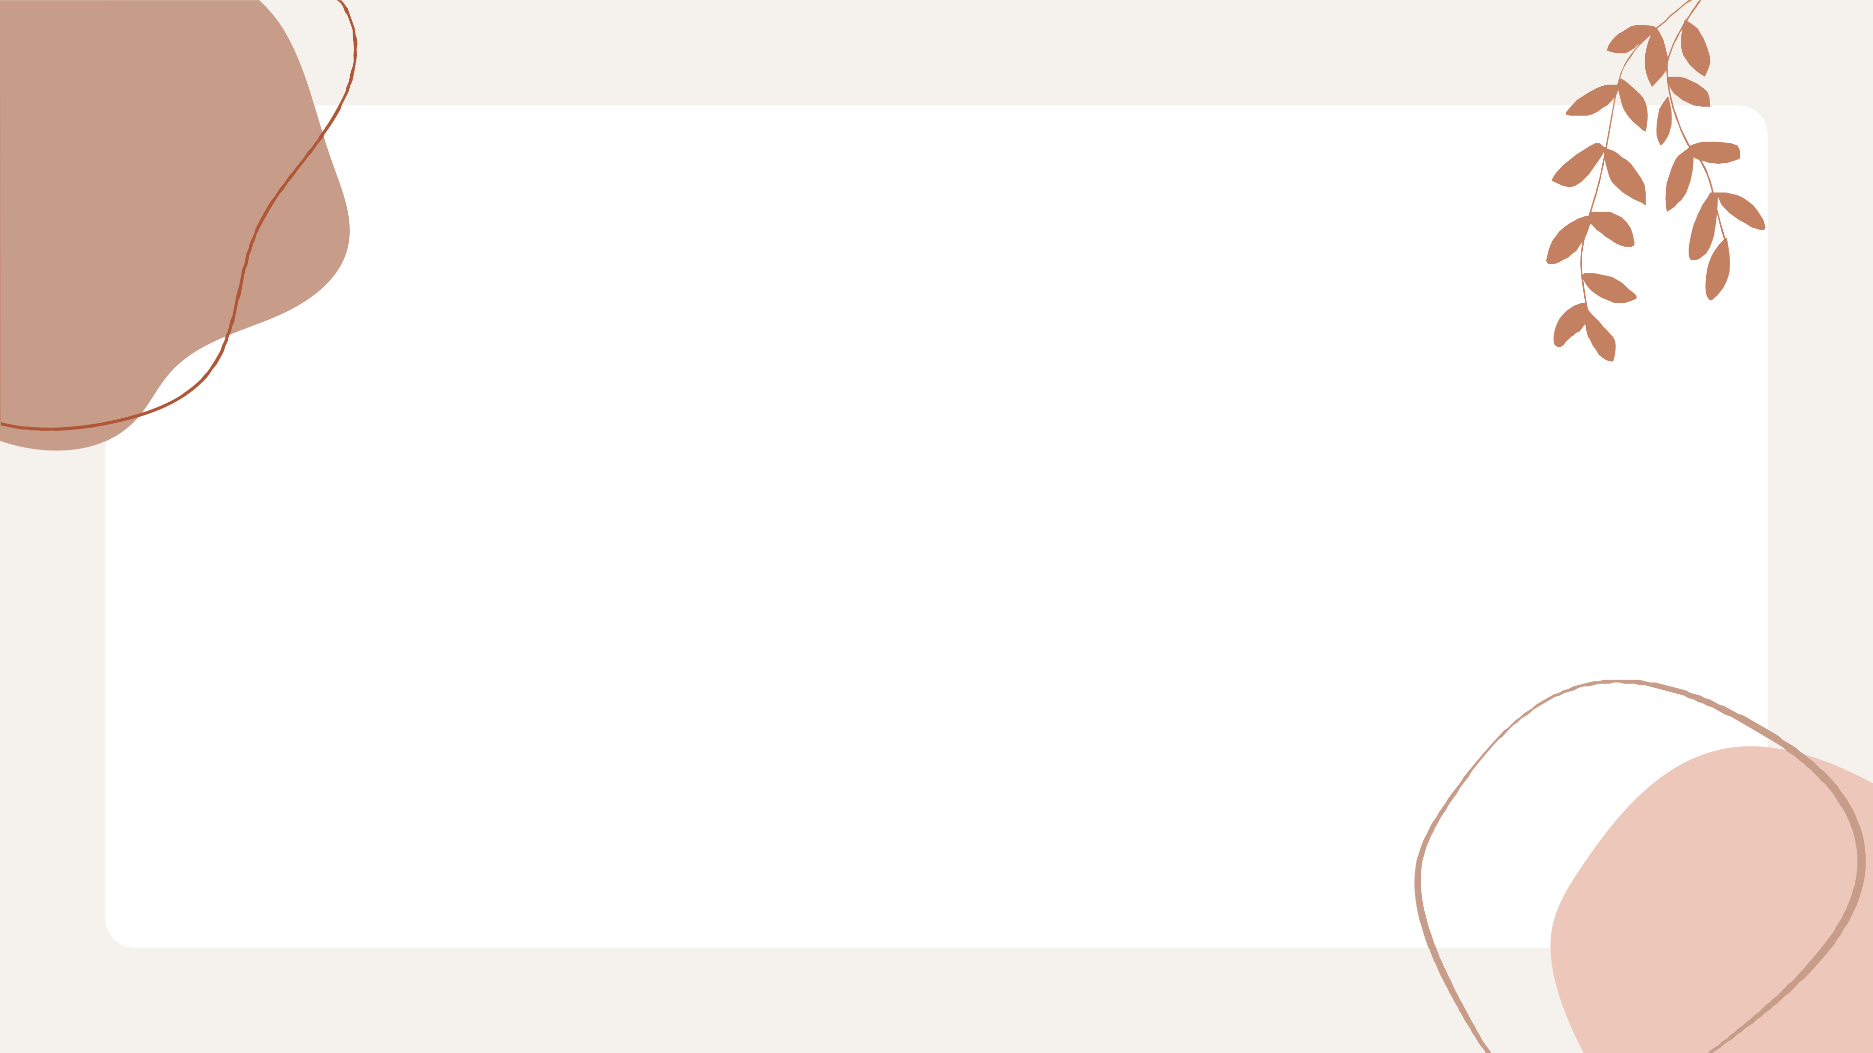
Health Monitoring System using IOT
Class Sy-A

Slide 2

Hello..Good Morning
2210283-Shrutika Raju Wagh 221081-Pratiksha Mohan Gurram 221087-Prasad Raghunath Labade 221080-Manish Mangesh Tambe

Slide 3

Introduction
With the commencement of the COVID-19 pandemic, social distancing and quarantine are becoming essential practices in the world. IoT health monitoring systems prevent frequent visits to doctors and meetings between patients and medical professionals. A smart health monitoring system is being developed using Internet of Things (IoT) technology which is capable of monitoring blood pressure, heart rate, oxygen level, and temperature of a person.
This system is helpful for rural areas or villages where nearby clinics can be in touch with city hospitals about their patient health conditions.The availability of high-speed internet allows the system to monitor the parameters at regular intervals. Furthermore, the cloud platform allows data storage so that previous measurements could be retrieved in the near future.

Slide 4

Demo

Slide 5
Health monitoring is very important in terms of prevention, particularly if the early detection of diseases can reduce suffering and medical costs. The diagnosis and prompt treatment of various diseases can radically improve alternatives for the medical treatment of the patient.
Abstract
This is particularly true in cardiovascular diseases and diabetes; the use of sensors can identify patients at risk by monitoring and transmission of vital signs

Slide 6
Health monitoring is generally proactive. Through periodical monitoring of the patient's health status, the health condition is predicted, and the required measures can be taken beforehand to prevent the full manifestation of the disease.
Motivation
The advancement in health sensors [7], wireless sensor network (WSN) [17], and wireless body area network (WBAN) [18] has enabled physicians to check a patient's health in a continuous manner, or whenever required.
Patients need not to be hospitalized; rather they are free to be at a place of their choice, generally at home.

Slide 7
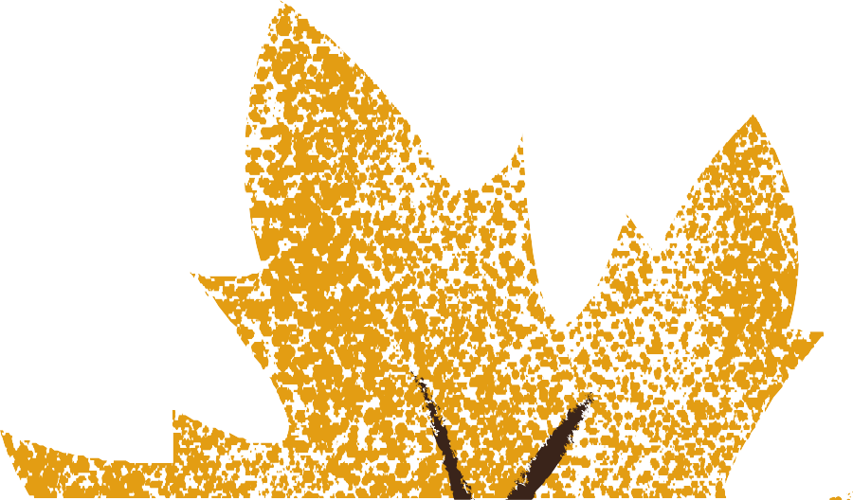
Aim of the System
To detect early symptoms of diseases which, in turn, reduces the emergency department visits
This increases the overall quality of the patient's life
Hospitalization expenses
Duration of stay in hospitals

Slide 8
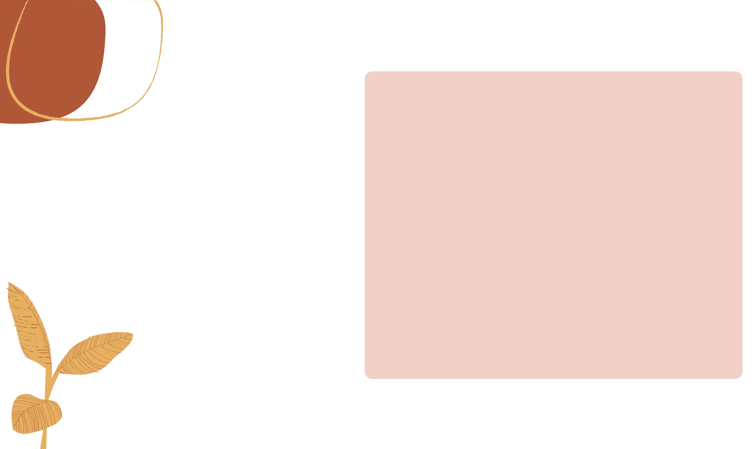
Architecture
In literature several IoT architectures are reported , this is because of the heterogeneity and the specific needs of the applications. In medical field, a five layers structure is typically used to model the IoMT based monitoring systems. In this hierarchical structure each layer has different purposes and items. Because today the most used technologies available for the automatic BP monitoring are based on oscillometric method and photopletismographic (PPG) analysis.

Slide 9
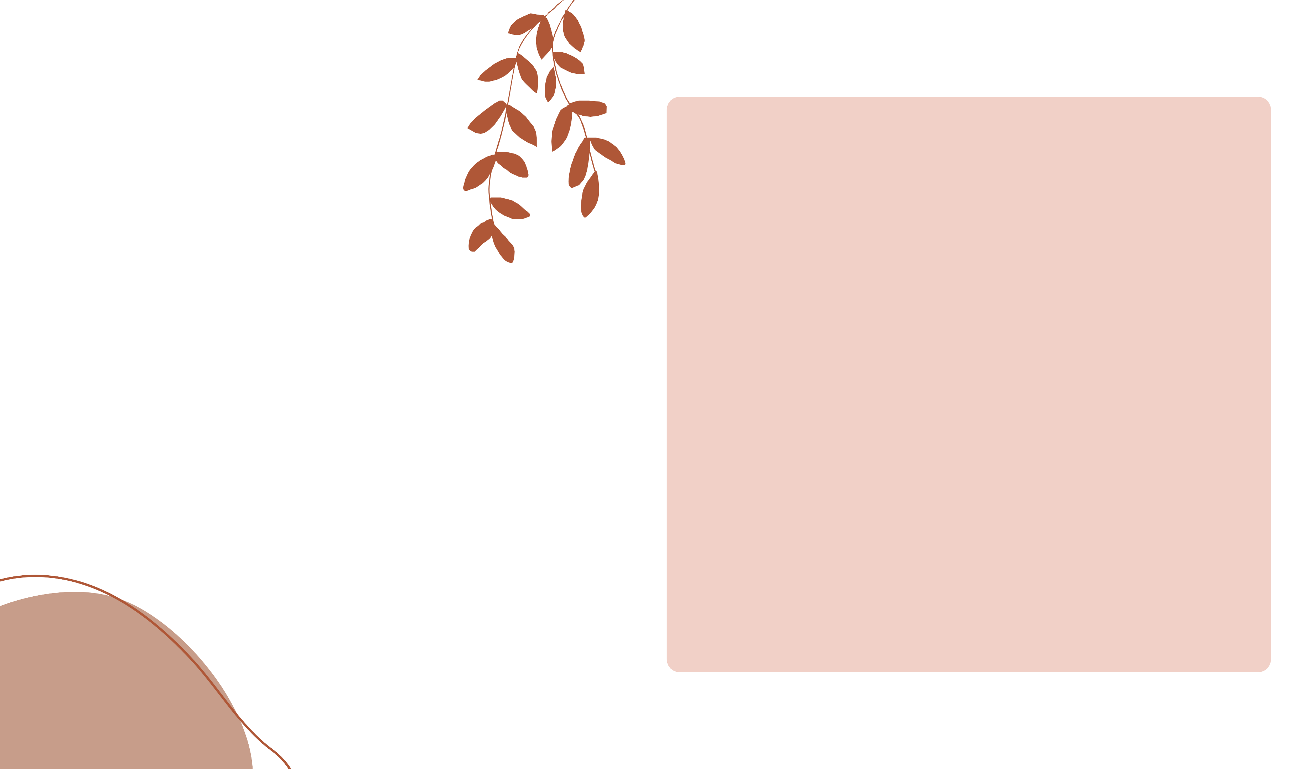
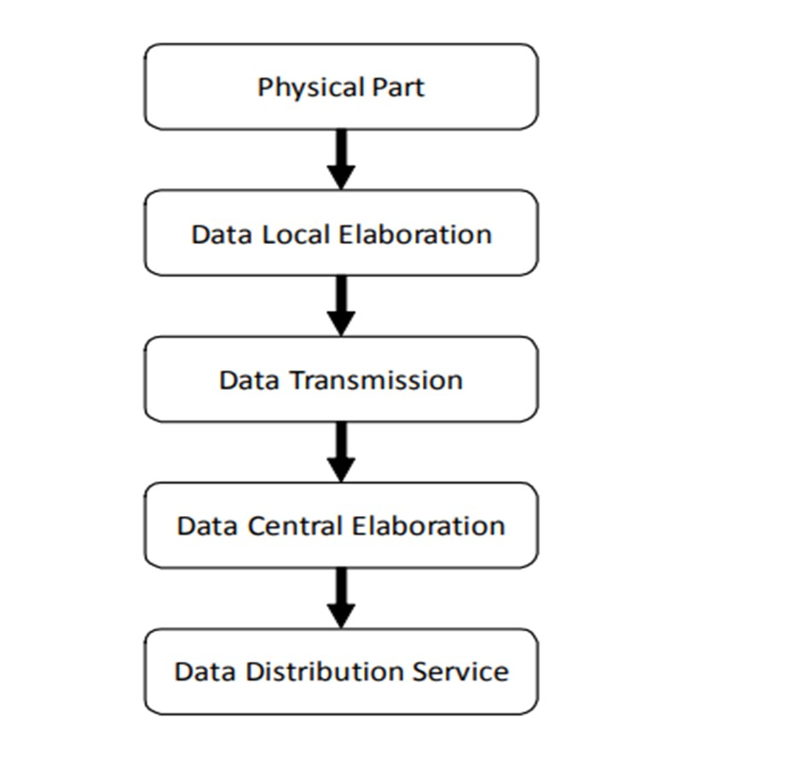
Architecture

Slide 10
FIVE LAYERS OF INTERNET of MEDICAL THINGS. (IoMT)
PHYSICAL PART
DATA LOCAL ELABORATION
DATA TRANSMISSION
DATA CENTRAL ELABORATION
DATA DISTRIBUTION SERVICE
( Sensors and Interpretation Techniques )
( Retrieval of Data from above layer and convert to digital form)
( Transmission of data and stored on cloud )
( Data re- elaborated , grouped and made accessible for remote control )
( Access to stored data )

Slide 11
Overview
In India, there are almost 31.7billion diabetes patients and blood pressure was recorded around 1,80,000 Indian Adults.
So, for monitoring every each individual person consist more time and not efficient.
Using other technologies identify accurately result for the problem, to give patient better cure is not possible
The main aim of the iot-health monitoring system is to offer the patient a prescription automatically according to his or her condition. The doctor can check patient health continuously without physical interaction and parameters can occur accurately
Health specialists and technicians have developed a great system with low-cost healthcare monitoring for people suffering from many diseases using common techniques such as wearable devices, wireless channels, and other remote devices
To measure each and every single parameter is very costly so we can merge and design combined device.

Slide 12
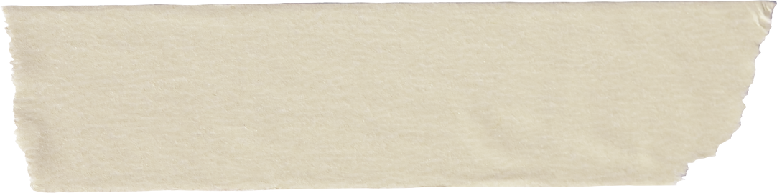
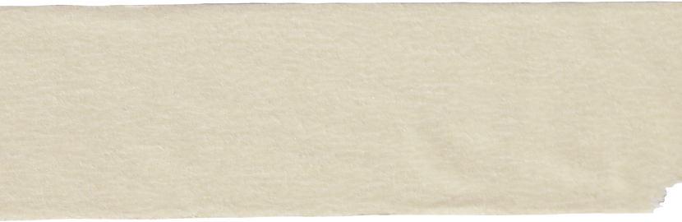
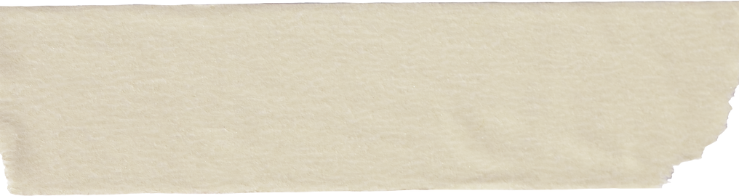
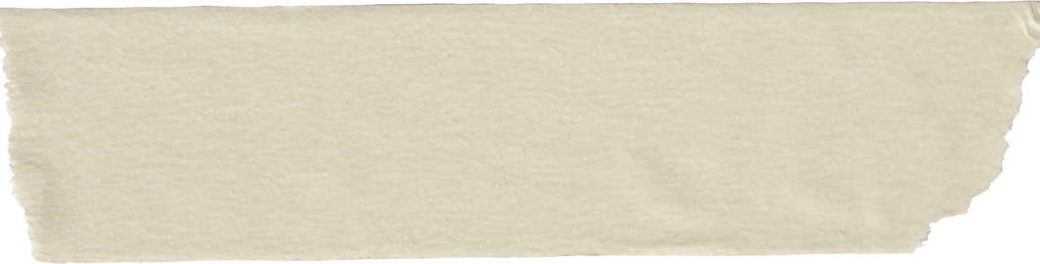
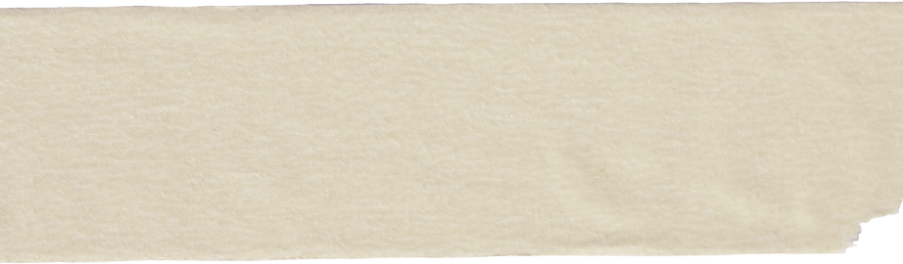
Challenges
Higher Flexibility
Possible lack of available memory
Security and privacy
Risk of failure
IoT integrated with the cloud increases the complexity.
Cost
Underdeveloped initiatives
Scalable Platforms

Slide 13
Advantages
Rendering doctor visit unnecessary daily, can give treatment in home itself
Increased patient comfort and convenience enable better patient satisfaction and faster recovery times.
Accessibility. Doctors can view all the necessary data on command and
check real-time patient conditions without leaving their office.
Not needed to wait in queue for general health check up, by staying home we can do treatment
When a person is unstable having emergency, then without waiting for doctor we can monitor health and can give treatment
Online monitoring and early warning of the health of the structure

Slide 14
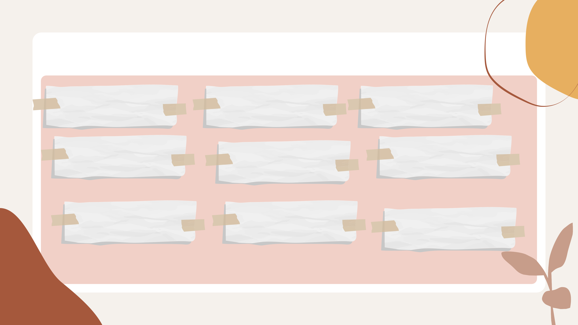
Applications
Covid19 tracker
Brain Signal Monitoring
Blindness
Diabetes
Cancer(kidney ,liver
,mouth)
Tumor Detection
Depression and mood monitoring
Paralysis
Temperature and BPM

Slide 15
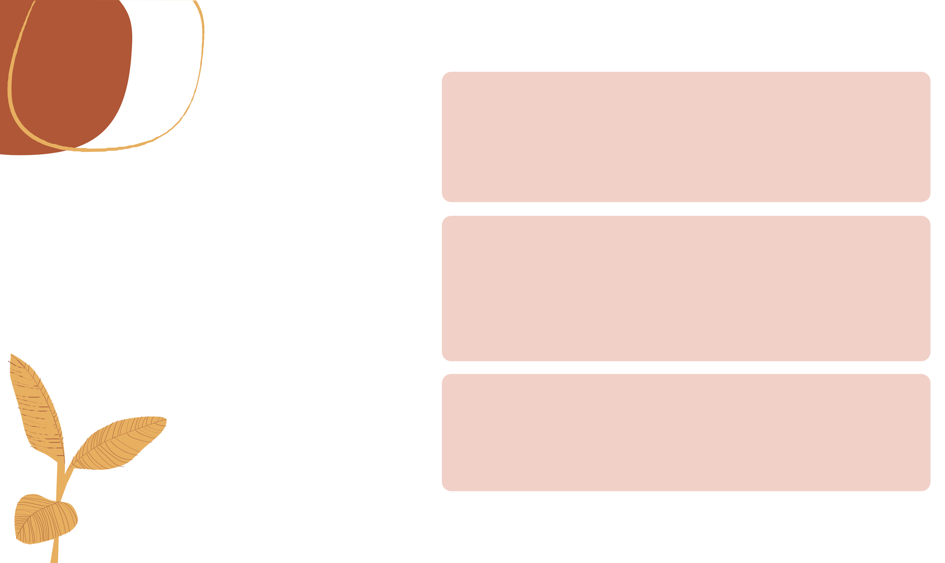
The model can be modified in future to build micro-sized sensors which can be placed everyone such as watch and mobile phones And the sensor can show live status of users on their smart phones.
The system may also be enhanced by including a module on diabetic patients who need insulin injections. This module would check blood sugar level of users, in case rises then it would alert the user to inject themselves with insulin shot to maintain the blood sugar level.
Future Scope
Our future work, will include how to secure access of data and will develop mobile application that allows access of the data on handled device

Slide 16
Conclusion
We can conclude that using iot in health monitoring system provide better diagnosis and instead of doctors being physically available the device can monitor the disease.
Monitoring of every individual can be done anywhere, anytime and quickly.
Compared to daily health monitoring , iot healthcare makes easier and comfort to patient Iot healthcare would save patients from critical loss of life and would help the doctor to take appropriate action at proper time.
The goal of using iot healthcare is to automatically gather data from patients and store the gathered data into cloud for permanent use that can help health professionals to remotely health monitoring

Slide 17
References
https://www.sciencedirect.com/science/article/pii/S2214785320318204 https://ieeexplore.ieee.org/abstract/document/9418487 https://ieeexplore.ieee.org/abstract/document/9396019
https://www.igi-global.com/chapter/patient-health-monitoring-using-iot/219853 https://www.youtube.com/watch?v=THNRx1sPbpw

Slide 18

Thank You!
Do you have any questions for me before we stop?

